Slide 1
Digital Portfolio
STUDENT NAME: NEHA KUMARI.P
REGISTER NO AND NMID: 212401015/
85A914420ABDB65B85B4A0FE8353E3D0
DEPARTMENT: COMPUTER APPLICATION
COLLEGE: PRINCE SHRI VENKATESHWARA ARTS AND SCIENCE COLLEGE /UNIVERSITY OF MADRAS

Slide 2
PROJECT TITLE
DIGITAL PORTFOLIO

Slide 3


AGENDA
Problem Statement
Project Overview
End Users
Tools and Technologies
Portfolio design and Layout
Features and Functionality
Results and Screenshots
Conclusion
Github Link
3/21/2024 Annual Review

Slide 4

PROBLEM STATEMENT
In today's digital world, having an online presence is crucial for professionals to showcase their skills and achievements. Many graduates and developers rely only on resumes, which limits their ability to highlight projects, skills, and creativity interactively. Therefore, a personal portfolio website is needed to present skills, projects, and contact information in a visually appealing and professional manner.

Slide 5

PROJECT OVERVIEW
This project is a personal portfolio website designed and developed for Neha Kumari (BCA Graduate | Frontend Developer).It highlights academic background, technical skills, completed projects, and provides a way for potential employers, collaborators, or clients to connect.The portfolio is responsive, modern, and styled with a blue theme for a professional look.

Slide 6

WHO ARE THE END USERS?
The website is useful for:Recruiters & Hiring Managers to assess skills and projects.Clients looking for freelance frontend development work.Peers & Developers to collaborate on projects.General Audience to know more about the developer's skills and work.

Slide 7

TOOLS AND TECHNIQUES
Frontend Languages: HTML5, CSS3, JavaScriptFrameworks/Libraries: React.js (optional for future upgrade)Version Control: Git & GitHubDesign Tools: Figma/Canva (for layout & design references)Deployment: GitHub Pages / Netlify/CodePen

Slide 8
POTFOLIO DESIGN AND LAYOUT
Header: Logo + Navigation Menu (About, Skills, Projects, Contact)Hero Section: Name, Title, Short Intro, CTA ButtonAbout Section: Brief bio with education and goals.Skills Section: List of technical skillsProjects Section: Cards for each project with title and descriptionContact Section: Email, GitHub link, and contact formFooter: Copyright and quick links8
8

Slide 9
FEATURES AND FUNCTIONALITY
Responsive Design Works on all screen sizes (mobile, tablet, desktop).Smooth Navigation → JavaScript smooth scrolling for section jumps..Contact Form → Allows visitors to send a message.Project Showcase → Displays multiple projects with details.Interactive UI → Hover effects and modern blue theme.GitHub & Email Integration → Direct access to repositories and communication.

Slide 10

RESULTS
A fully functional portfolio website hosted online.Enhanced personal branding and professional visibility.Easy access for recruiters and clients to connect.Scope for future improvements such as adding a blog, live project demos, or backend integration
3/21/2024 Annual Review
10

Slide 11
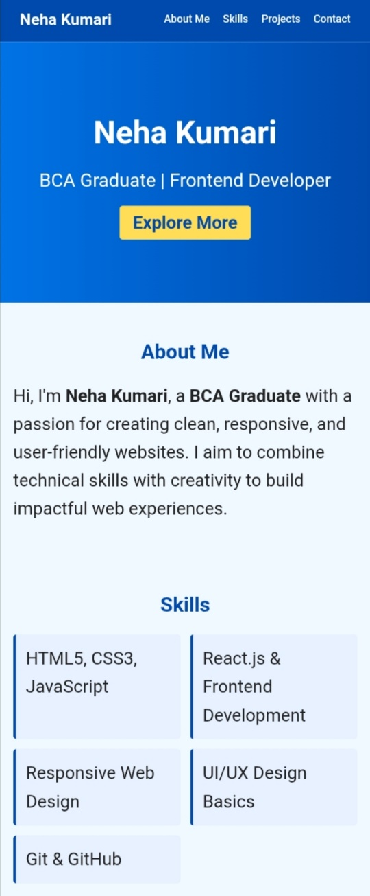
SCREENSHOTS

Slide 12
CONCLUSION
The portfolio successfully provides a professional online presence for Neha Kumari. It addresses the problem of limited exposure through resumes by offering a dynamic and visually appealing platform.
12

Slide 13
GITHUB LINK:-
https://neha28sharma8-create.github .io/TNSDC-FWD-DP/

